Slide 1


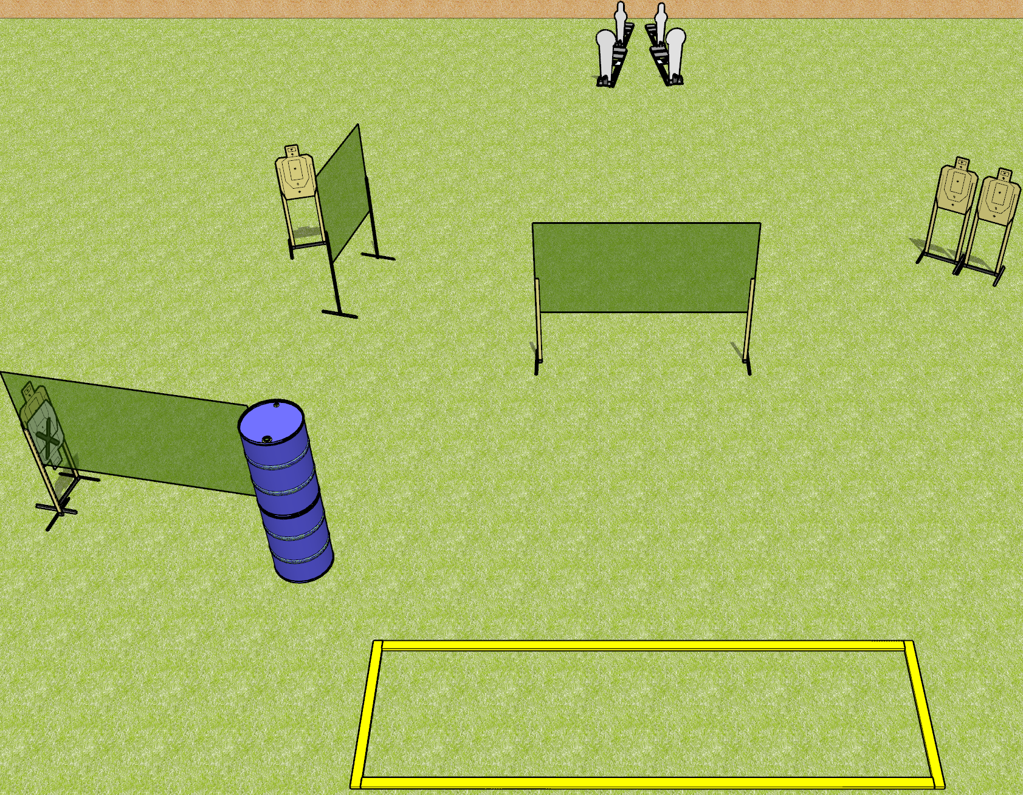
 | Dothan Gun Club – USPSA Match Keep it Short Course Designer : Drew Coleman
Round Count 12 rounds 4 USPSA 2 colt poppers, 2 mini poppers
Equipment List 6 wall feet 4 8’ fault lines, 2 medium fault lines

Slide 2
Keep it Short
Written Stage Briefing
Keep it Short is a 12 round, 60 point, Comstock course of fire. There are 4 USPSA targets, 2 colt poppers, and 2 mini poppers. The best 2 hits on paper will score, and steel must fall to score. The start signal is audible.
Handgun start position is completely outside the shooting area, wrists above shoulders. Handgun is UNLOADED and holstered.
PCC start position is completely outside the shooting area, stock on belt. Carbine is UNLOADED.
On start signal, engage targets as they become available from within the shooting area.

